Slide 1


SWITCH IN COMPUTER NETWORKS
BY JAWAD AHMED
01
Notes:
"Good morning, everyone. Today I’m going to present a basic but very important device used in computer networking — the Switch. It plays a key role in how data flows efficiently across networks."

Slide 2



Switch in Computer Networks
INTRODUCTION
A switch is a networking device that connects devices within a LAN.
It uses MAC addresses to forward data to the correct device.
02
Notes:
"A switch operates at the Data Link Layer (Layer 2) of the OSI model. It connects multiple devices in a Local Area Network (LAN), such as computers, printers, and servers. What makes a switch smarter than a hub is that it reads the MAC address of incoming data packets and sends them only to the intended recipient, not to all devices."

Slide 3
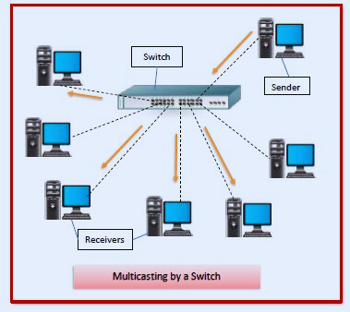
Switch in Computer Network
HOW DOES A NETWORK SWITCH WORK?
Switch reads the MAC address from the data packet to find the destination.
It creates a temporary direct path for data transfer and avoids collisions.
03
Notes:
"When a source device sends a data packet, it first enters the switch. The switch reads the packet's header and identifies the destination's MAC address. Based on this, it forwards the packet through the correct port, directly to the destination device.
The switch establishes a temporary connection just between the sender and receiver, and once the data transfer is done, it closes that path. This process allows full bandwidth for both incoming and outgoing data, helping reduce data collisions and increase speed."

Slide 4
Switch in Computer Network
HOW A SWITCH ESTABLISHES TEMPORARY CONNECTIONS
Devices communicate in assigned time slots.
Switch uses control logic to map inputs to outputs.
04

Slide 5
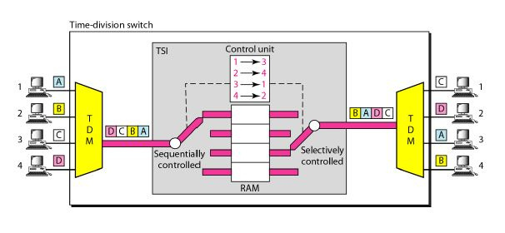
Switch in Computer Network
HOW A SWITCH ESTABLISHES TEMPORARY CONNECTIONS
05
Notes:
"This diagram illustrates a Time-Division Switch — a type of network switch that uses time slots to control communication between devices.
On the left, four devices A, B, C, and D are sending data. Each one is assigned a specific time slot. The switch reads the control instructions stored in RAM and establishes a path for each device, one at a time.
For example, A (from time slot 1) is routed to output 3. Similarly, B, C, and D are mapped to different outputs like 1, 4, and 2. This temporary switching avoids collisions and ensures orderly data transfer based on timing."

Slide 6
Switch in Computer Network
ADVANTAGES
Efficient data transfer with reduced collisions.
Provides dedicated bandwidth to each device.
06
Notes:
"Switches are very efficient at managing network traffic. They reduce unnecessary data collisions because they send data only to the intended device.
Also, switches offer dedicated bandwidth — meaning multiple devices can communicate at the same time without slowing each other down. This improves both speed and performance of the network."

Slide 7
Switch in Computer Network
DISADVANTAGES
More expensive than hubs.
Can be complex to manage in large networks.
07
Notes:
"While switches offer better performance, they are costlier than basic devices like hubs. This can be a concern in very large networks.
Additionally, in big enterprise setups, managing many interconnected switches can become complex and may require network administrators or additional configuration tools."

Slide 8
Switch in Computer Networks
ANSWERS TO QNA’S
WHATEVER ASSIGNED DEVICE IS INTELLIGENT OR NOT?
Yes it is Intelligent Device.
WEATHER ASSIGNED DEVICE IS HARDWARE OR IT MAY WORK ON SOME SOFTWARE?
It is Hardware device that runs on built in software.
WEATHER ASSIGNED DEVICE BUFFER AND FORWARD DATA OR NOT?
Yes, a switch buffers and then forwards data to the destination.
WHICH OSI LAYER IT WORKS.
Primarily operates at Layer 2 (Data Link Layer).
08
Notes:
"Switches don’t just instantly send data; they first store it briefly in a buffer, check for errors or correct destination, and then forward it. This reduces collisions and improves reliability."

Slide 9


THANK YOU

